Slide 1



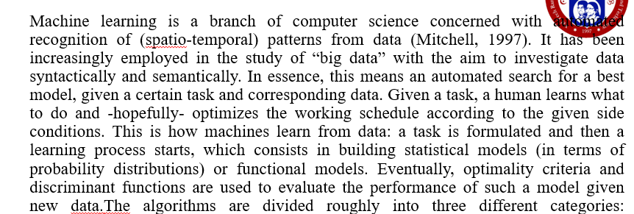
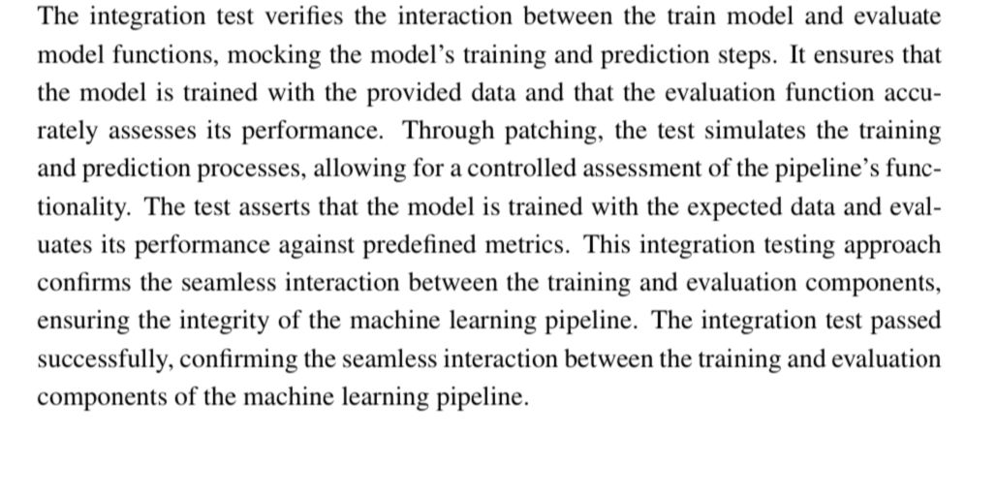
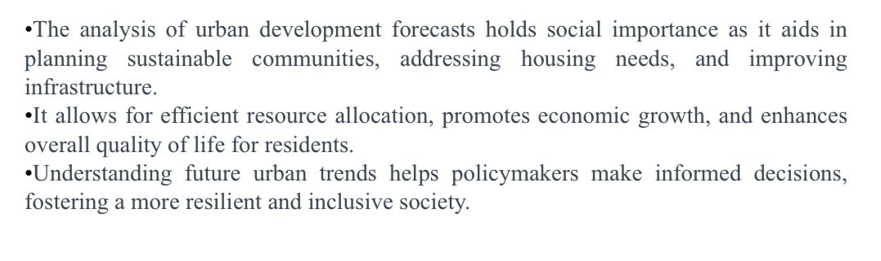
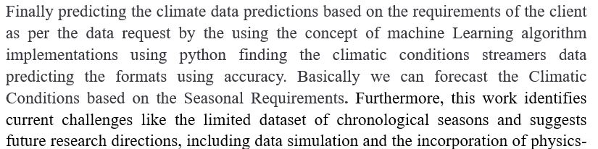
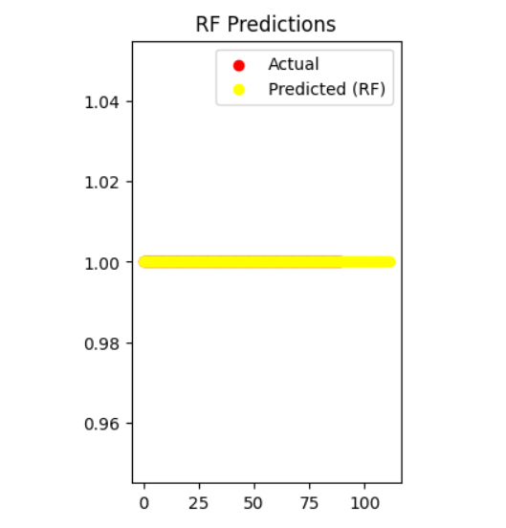
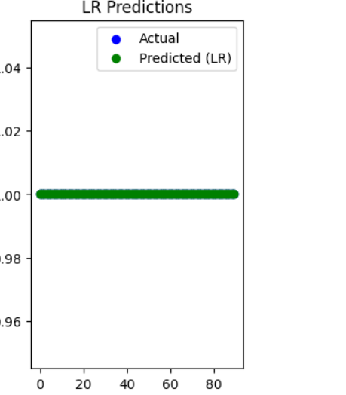
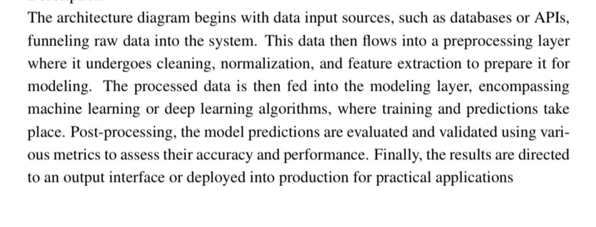
CLIMATE STREAMERS IDENTITY PREDICTIONS
Department of Computer Science and Engineering Batch: (2020-2024)
School of Computing
1156CS701-MAJOR PROJECT
INTERNSHIP THROUGH DIND/PLACEMENT/ABROAD
INDUSTRY/INSTITUTE NAME
WINTER SEMESTER 2023-2024
ABSTRACT
INTRODUCTION
RESULTS
STANDARDS AND POLICIES
Weather and climate prediction have been crucial in human history for enabling effective agricultural planning, safeguarding against natural disasters, and facilitating strategic decision-making in various sectors. In this context, the need for accurate and timely forecasting is highly significant. Machine learning has the potential to improve the accuracy and speed of weather and climate prediction. This comprehensive survey assesses the efficacy of Machine Learning (ML) and Machine Learning-Enhanced (ML-Enhanced) methodologies in short-term weather forecasting and medium-to-long-term climate prediction
CONCLUSIONS
Table 1. Label in 20pt Calibri.
TEAM MEMBER DETAILS
<Student 1. vtu 17173/M RAKESH>
<Student 2 .vtu 18173/M V BHARGAV>
<Student 3 .vtu 17370/G HEMANTH>
<Student 1. Phone no 6281795822>
<Student 2. Phone no 9908446747>
<Student 3. Phone no 8367651381>
<Student 1. Mail ID vtu17173@veltech.edu.in>
<Student 2. Mail ID vtu18173@veltech.edu.in>
<Student 3. Mail ID vtu17370@veltech.edu.in>
METHODOLOGIES
ACKNOWLEDGEMENT
K Maithili asst proferser
9790626076
kmaithili@veltech.edu.in
Chart 1. Label in 20pt Calibri.

